Slide 1
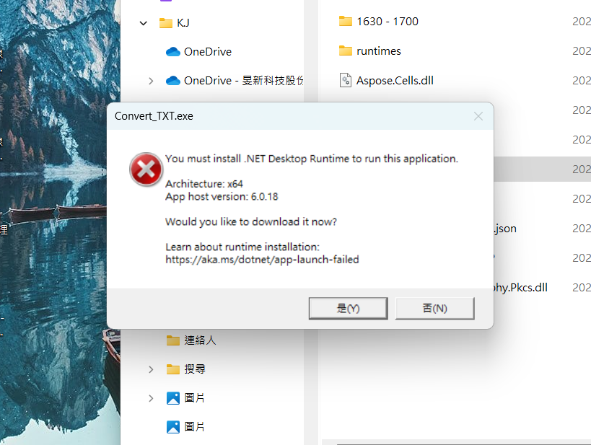
Warning
If an error occurs，Please follow the instructions below

Slide 2
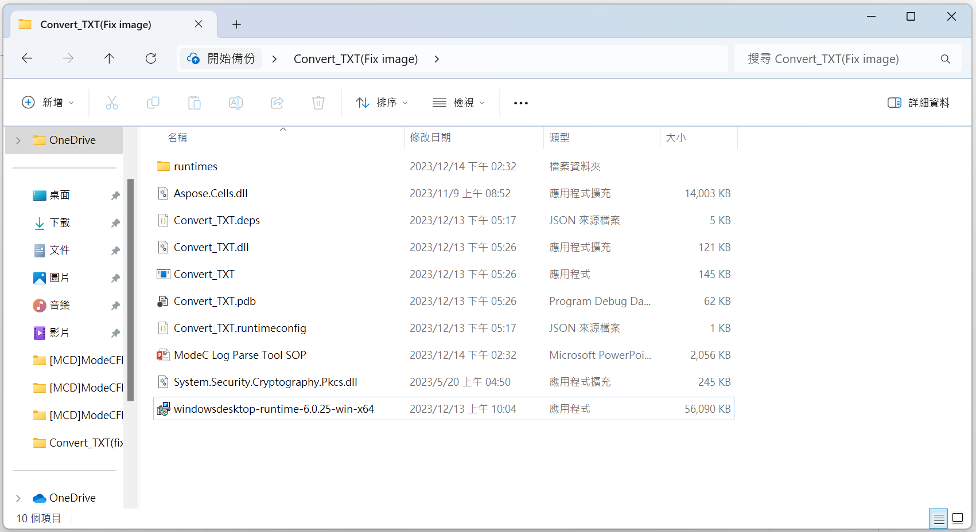
Download .Net
1
點選執行檔

Slide 3
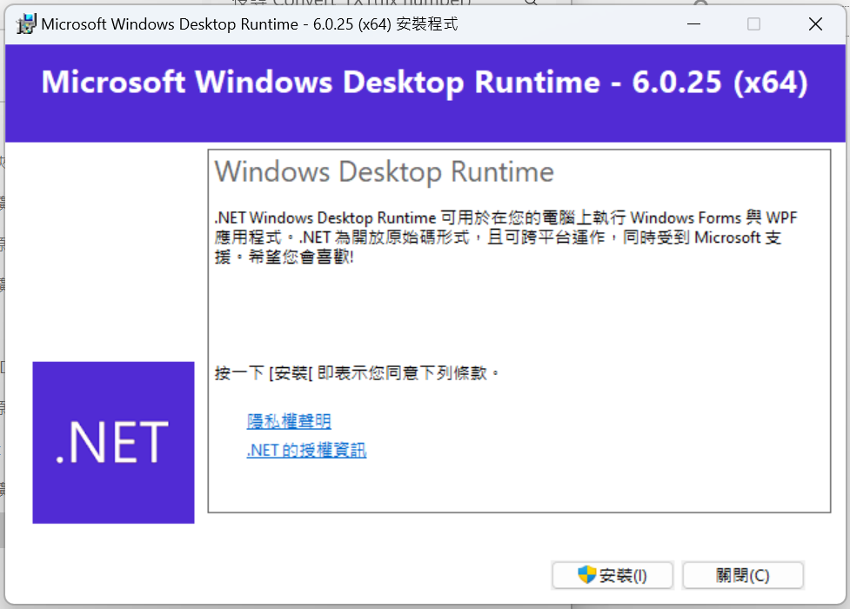
Download .Net
2
點選安裝

Slide 4
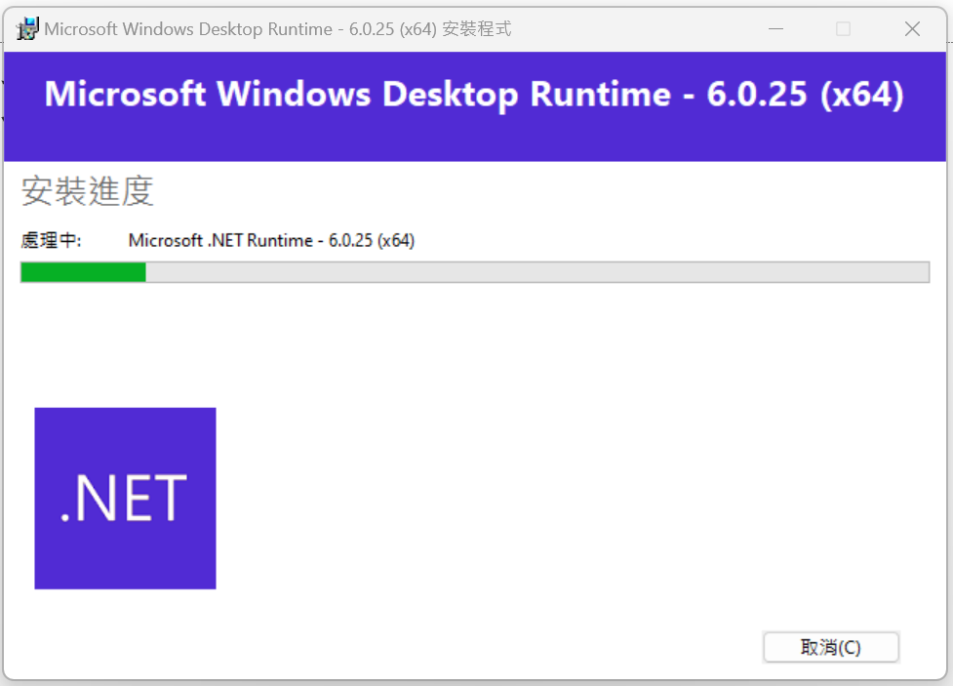
Download .Net
等待安裝完成…

Slide 5
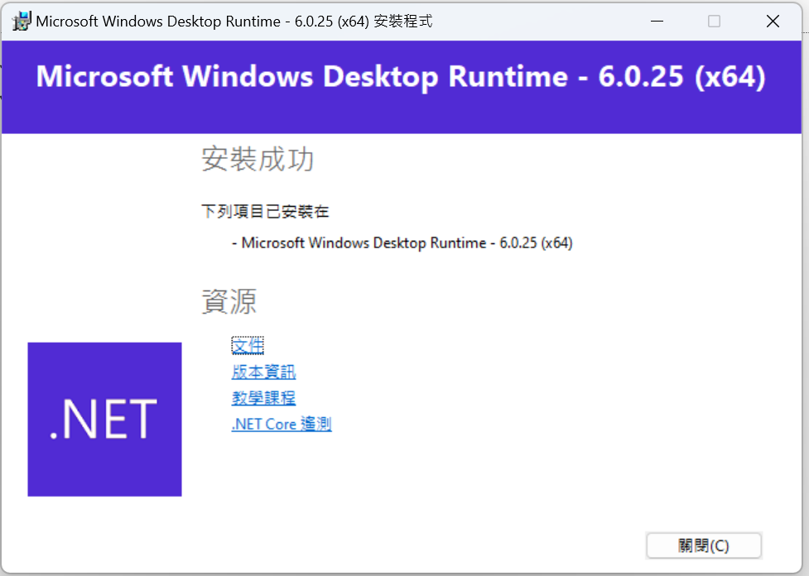
Download .Net
安裝完成

